Slide 1
Monoalphabetic Substitution Cipher- Task 1
Aniket Dere
Matriculation Number: 60334138

Slide 2
Introduction
The Monoalphabetic Substitution Cipher is a traditional encryption technique where each letter in the plaintext is replaced by a letter some fixed number of positions down the alphabet. This report explores decrypting such ciphers without the original key.

Slide 3
Methodology
The process begins with Alice sharing an encrypted text, which is then stored in a database. Oscar retrieves this encrypted text from the database for decryption.

Slide 4
Logic and Implementation
Key methods: 'initializeKeys()', 'Encrypt()', 'Decrypt()'.
Decryption logic involves identifying single letters and generating a key based on assumptions. The decrypted text's validity is checked against common words. The process iterates until a valid decryption is achieved.

Slide 5
Conclusion
This report presents a method for decrypting texts encrypted using the Monoalphabetic Substitution Cipher with original key and without the original key. It highlights potential vulnerabilities in traditional ciphers.

Slide 6
Appendices
Alice will share enter the text which need to transfer to bob via encrypted message so:
I am taking user input so that alice can enter text.
“RSTUVWXYZABCDEFGHIJKLMNOPQ” key is transfer to BOB in secure manner so that he can use it to read the message.
As shown in above fig.1 Oscar will get the encrypted text from Database.
However BOB get the key and he decrypt the message.

Slide 7
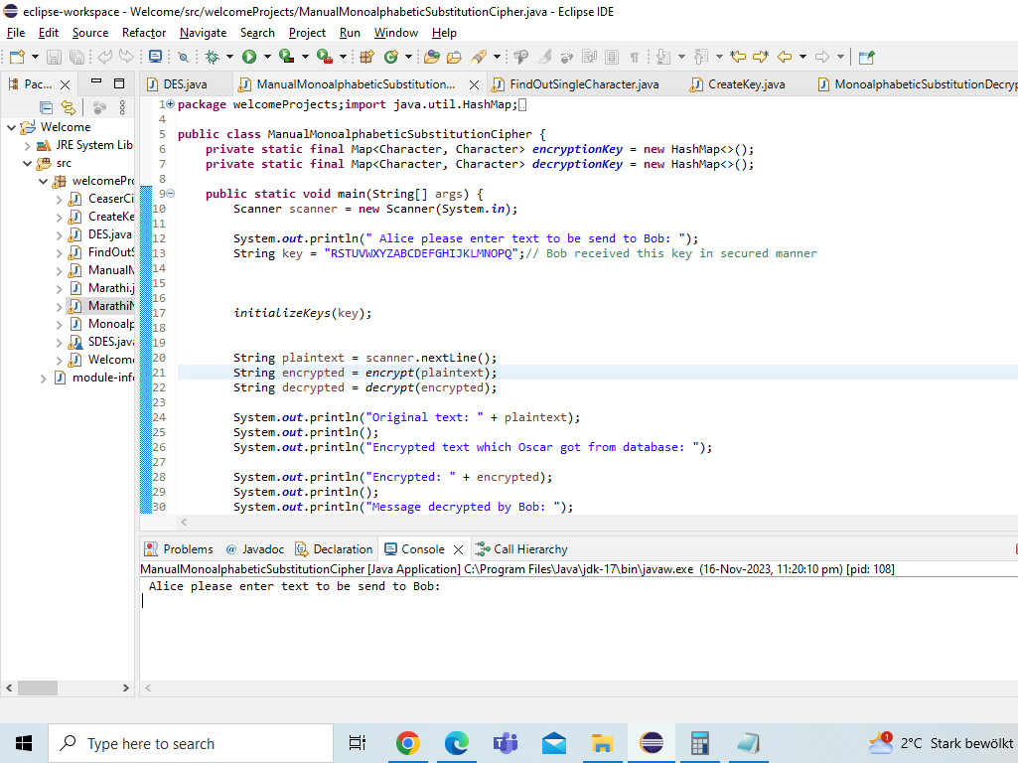

Slide 8
Logic:
Public method: initializeKeys() method will store alphabets and corresponding character in map in form of key and value pair.
Encrypt() method will assign corresponding letter stored in Map of encryptionKey Map variable to characters present in the string.
Similarly decrypt() method will assign characters store for corresponding descryption value of MAP key for all characters present in the cipherText String.

Slide 9
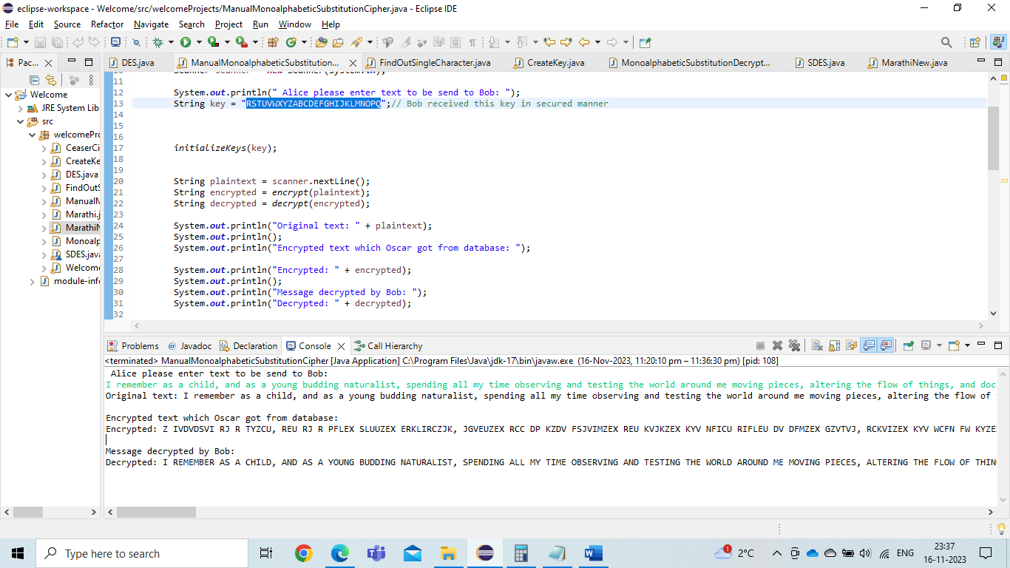

Slide 10
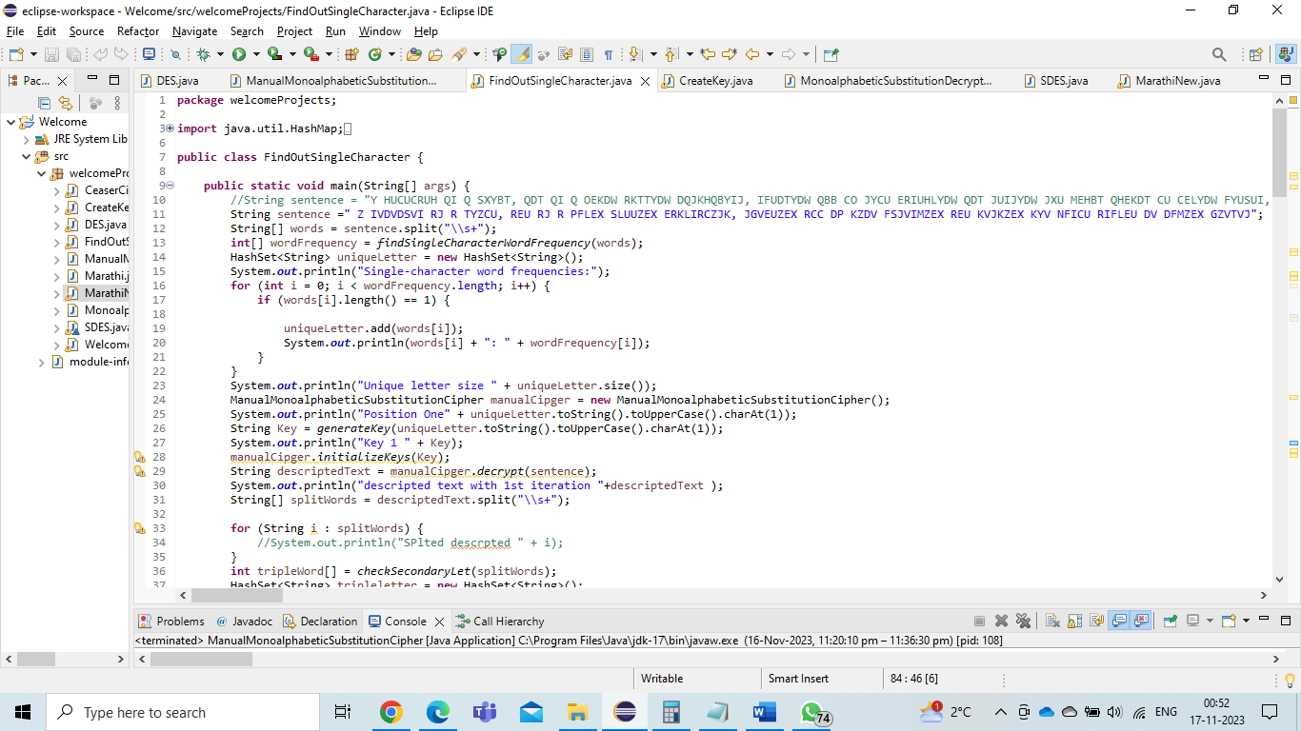

Slide 11
Logic to decrypt without key
Above class FindOutSingleCharacter take cipher text which Oscar got from database and then all letters splitted based on space character and stored in words[].
Logic behind hacking the cipher text:
I am detecting all single letters present in the paragraph after ciphering.
Single letters are mostly “A” and “I” so I am generating key considering key as A.
After decrypting text by considering Key A same output is searched for 3 letters String. Mainly 3 characters Strings are { "AND", "THE", "NOT", "BUT", "ODD", "MUD", "OUR", "ARE", "YOU", "USE" }
These strings are compared with decrypted output compareWithThreeLettersFromPara()
If we found the match output or descrypted output is printed.
If we don’t have A and want to decrypt based on I or other characters then same loop is repeated and instead of A , I am using any other character present the paragraph as basic word to generate the key.

Slide 12
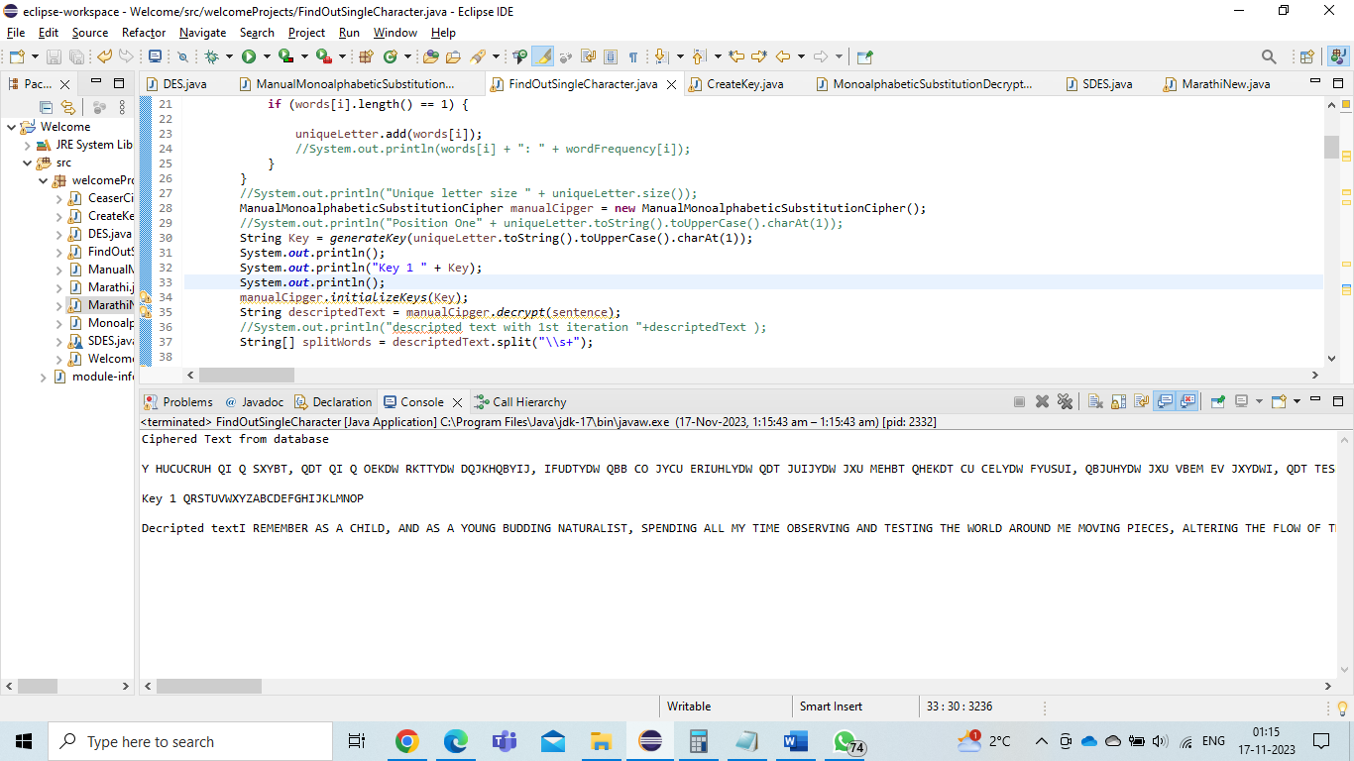

Slide 13
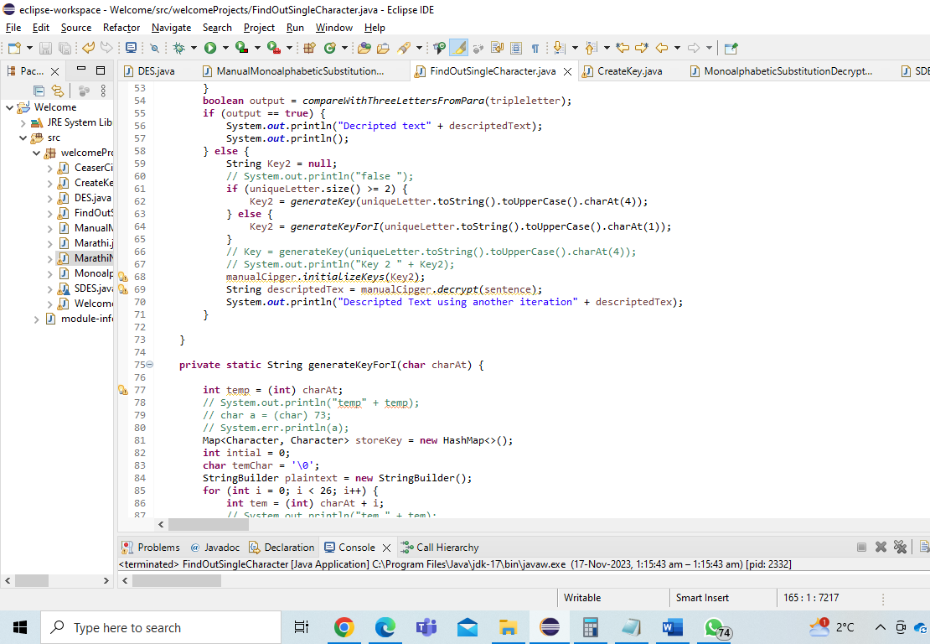

Slide 14
Mono alphabetic cipher using marathi Language
Marathi is my regional language from India.
This language includes letter from Devnagari letter.
In order to cipher the text using, I am using ascii value of corresponding letters which will be later take 128 modulus operation from base ascii value of the starting alphabet (आ).

Slide 15
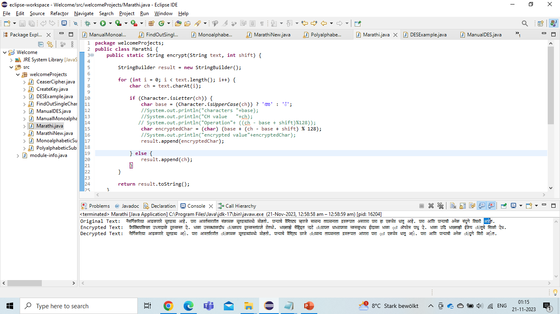
encrypt(String text, int shift) method

Slide 16
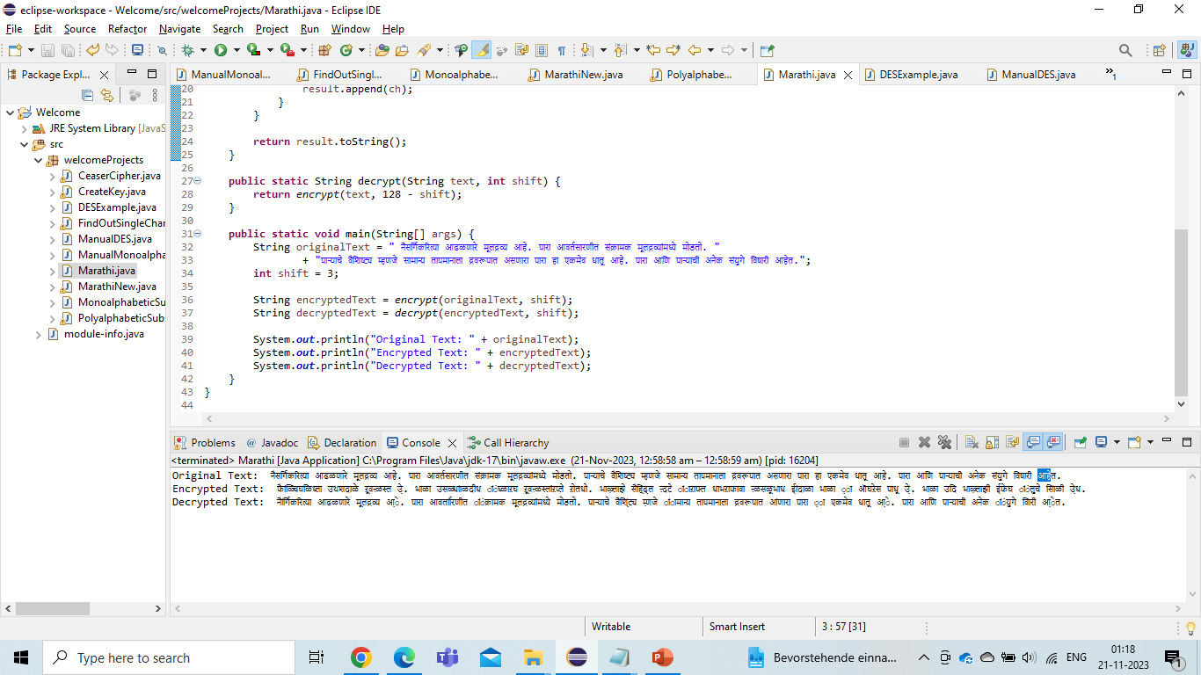
decrypt(String text, int shift) and input and output

